Slide 1

DOM( Document Object Model)
Made by: Muniba Javaid

Slide 2
Document Object Model
HTML DOM methods are actions you can perform (on HTML Elements).
HTML DOM properties are values (of HTML Elements) that you can set or change.
The HTML DOM can be accessed with JavaScript (and with other programming languages).
In the DOM, all HTML elements are defined as objects.
The programming interface is the properties and methods of each object.
A property is a value that you can get or set (like changing the content of an HTML element).
A method is an action you can do (like add or deleting an HTML element).

Slide 3
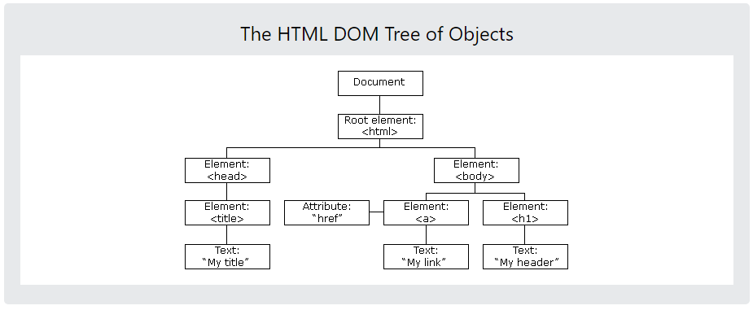
Cont…
The DOM is the Document Object Model, which deals with the document, the HTML elements themselves, e.g. document and all traversal you would do in it, events, etc.

Slide 4
Example 1
<button onclick="button_click()">Click me</button>
<h2 id="heading2">Some Random Text </h2>
<script>
function button_click()
{
document.getElementById("heading2").innerHTML="hello";
}
</script>

Slide 5
Example 2
<button onclick="button_click()">Click me</button>
<h2 id="heading2">Some Random Text </h2>
<script>
function button_click(){
var str = document.getElementById("heading2").innerHTML;
alert(str);
}
</script>

Slide 6
Example 3
<script>
function button_click(){
document.getElementById('img1').src = "River_Swat_Pakistan_3.jpg";
}
</script>
<button onclick="button_click()">Click me</button>
<img src="micky mouse.png" alt="myImg" width="250" height="300" id="img1"/>

Slide 7
Example 4
<center>
<form>
<input type="text" id="txtName" placeholder="Enter Your name" />
Male : <input type="radio" name="gender" value="Male" />
Female : <input type="radio" name="gender" value="Female" />
<br /><br />
<img src="" alt="myImg" width="250" height="300" id="img1"/>
<br /><br />
<button type="button" onclick="cal_function()">Click here</button>
</form>

Slide 8
DEMONSTRATEJAVASCRIPT CALCULATOR EXAMPLE

Slide 9
DEMONSTRATE JAVASCRIPT BOOK EXAMPLES

